Slide 1

Action taken report
Analysis of datasets (customer feedback, job card, Bill Data).
Time series Analysis on Service type.
Customer feedback collection through Google Forms

Slide 2

Insights from Financial Analysis

Slide 3
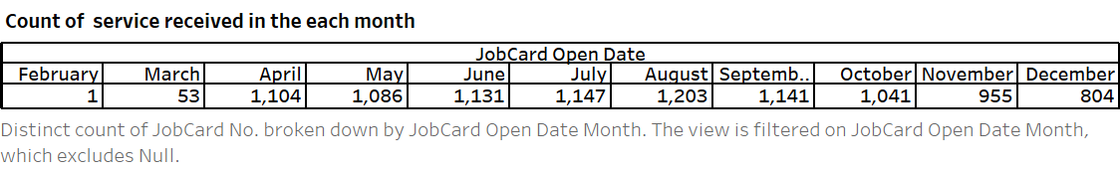
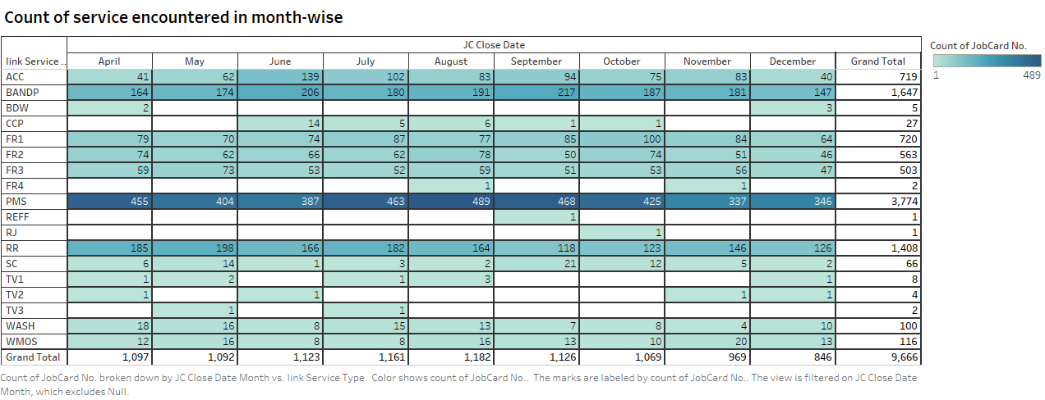

Slide 4
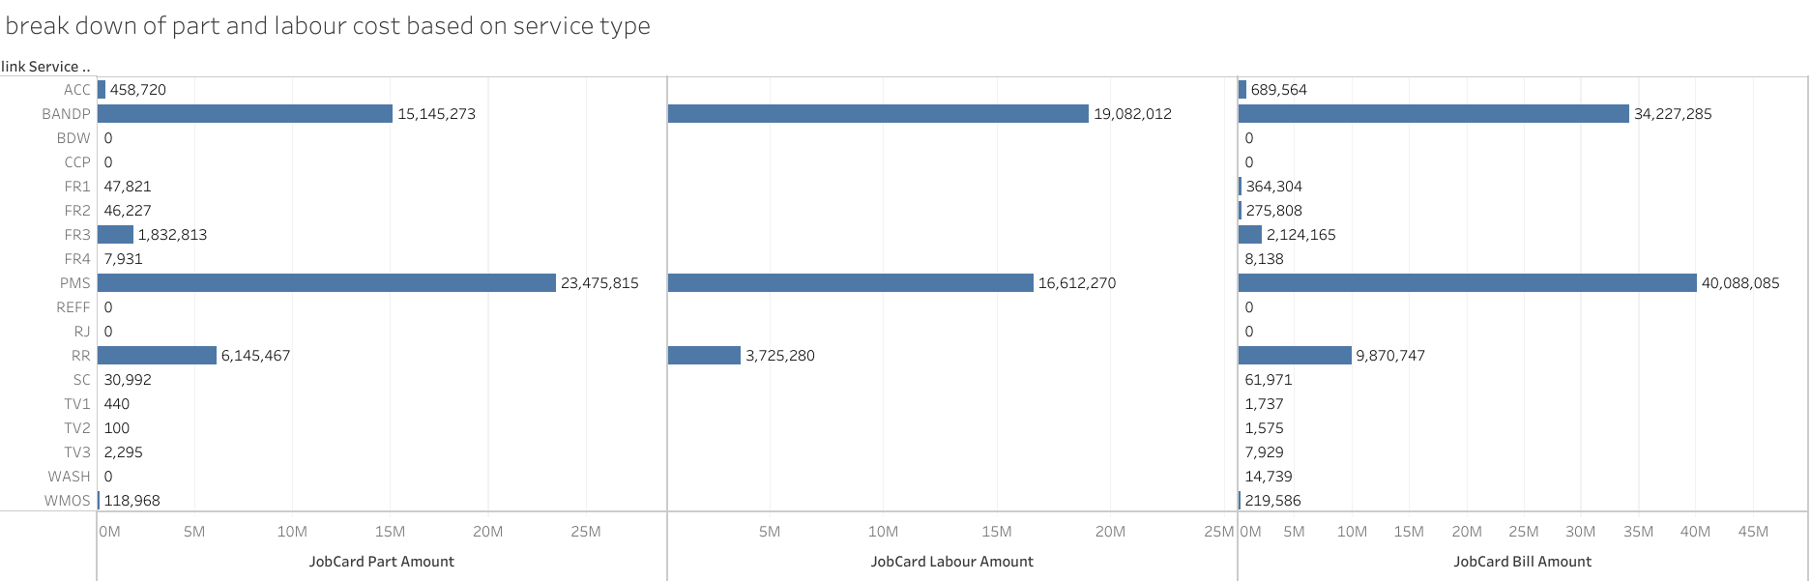

Slide 5
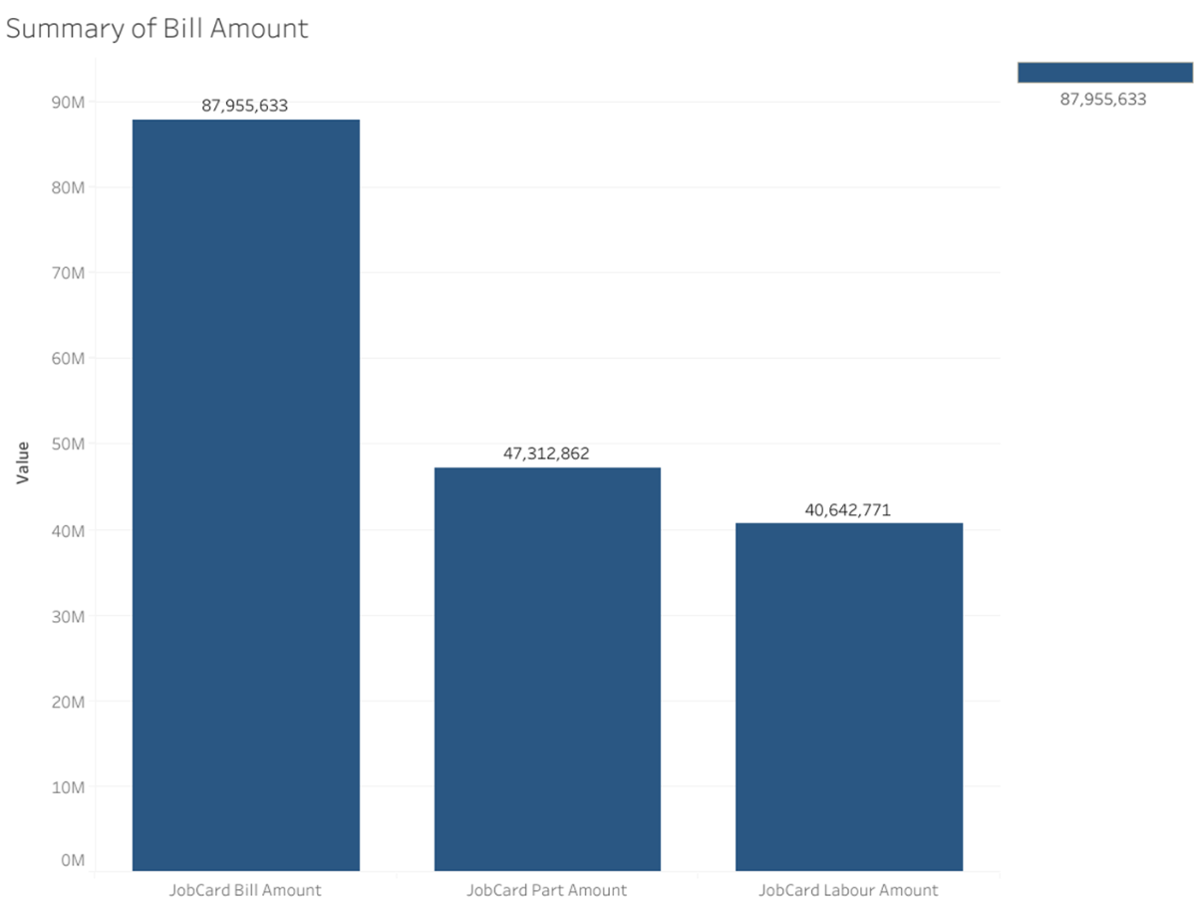
This Viz defines us the Summary Bill Amount generated in the Service station
1.From the Job card , we analyzed that part amount is higher compare to the labor amount .
2.The service encounter by the station , where the Job card part amount is around 4.7Cr an labor amount generated is around 4 Cr

Slide 6
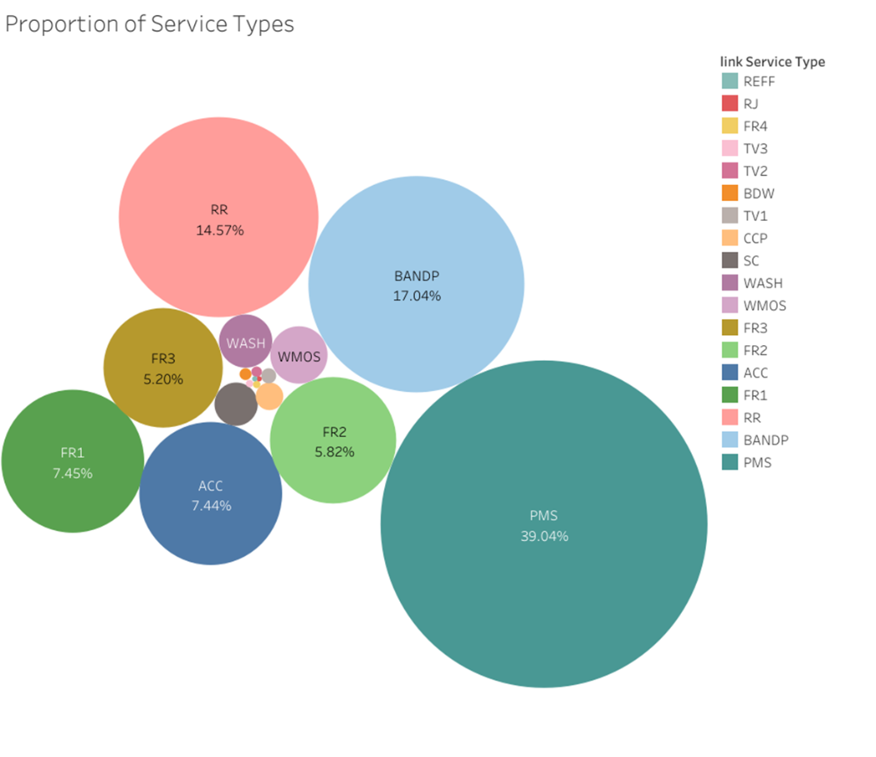
This Viz defines us the proportion of service that being handled by the Service station
1. PMS ( Periodic Maintenance service ) is the most accessed service in the service station with around 39% .
2.Next to that we have BANDP , with second most accessed service around 17%.
3.From that Viz ,we can see that Summation of the Free service is literally around 16- 17 %

Slide 7
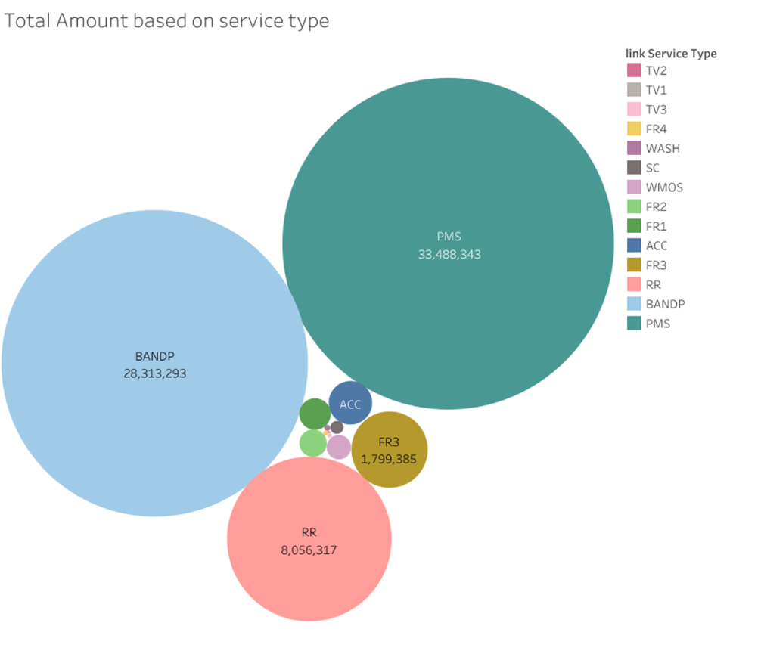
From this viz , we able to understand that amount generated by the service that encounter in the service Center
1. PMS ( Periodic Maintenance service ) is the most accessed service and most revenue generated service in the service station with around 3.3Cr .
2.Next to that we have BANDP , with second most accessed service and the revenue generated by that service is around 2.8Cr

Slide 8

Insights from Time Series Analysis

Slide 9
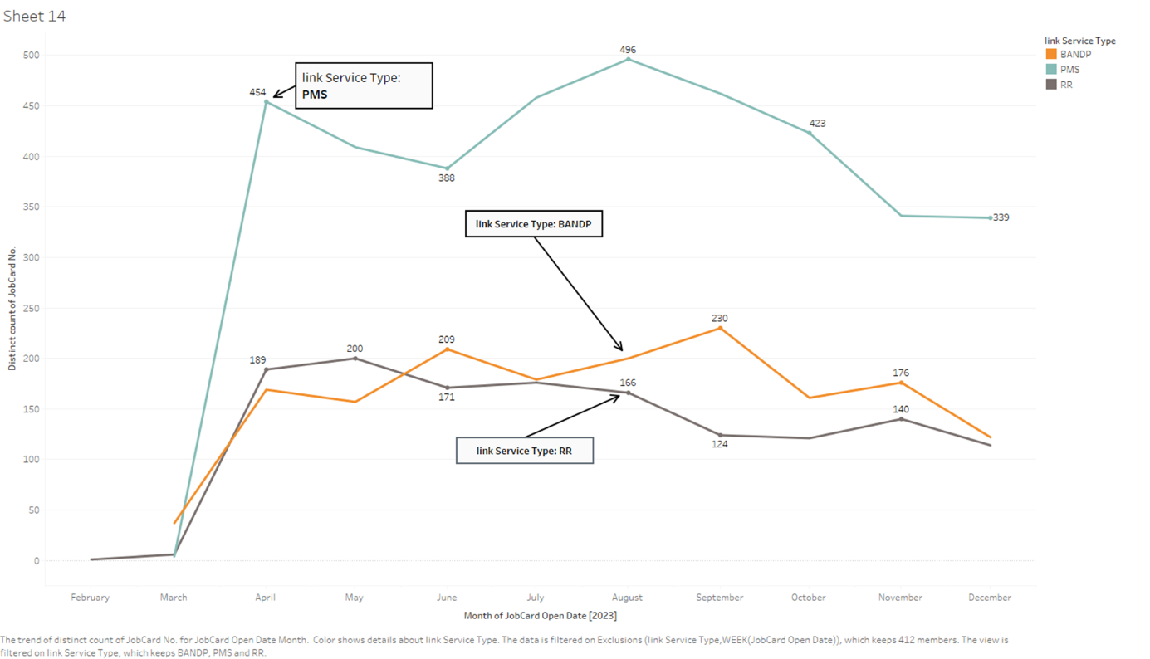
Time Series Analysis

Slide 10
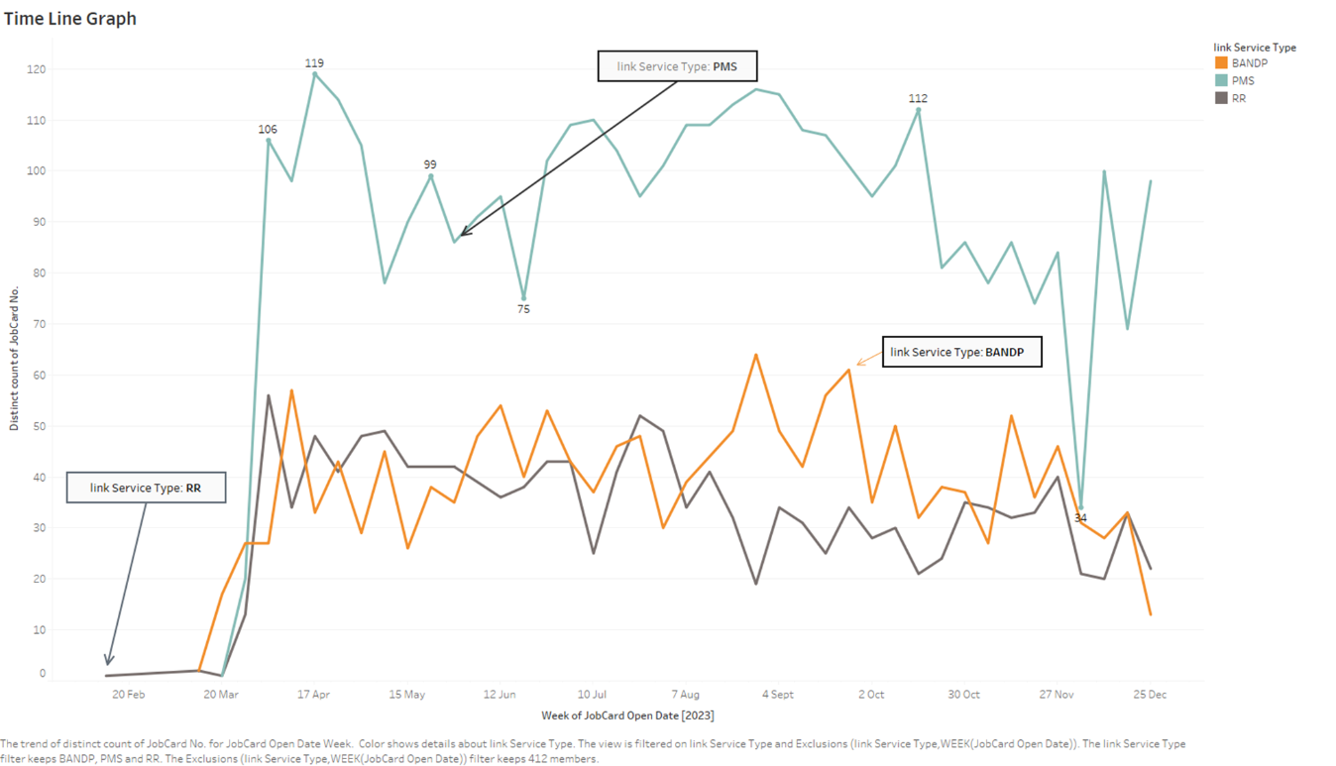
For the time series analyze we analyzed the most accessed such PMS , RR, BANDP .
From analyze the viz we found that there is relationship occurred with season

Slide 11
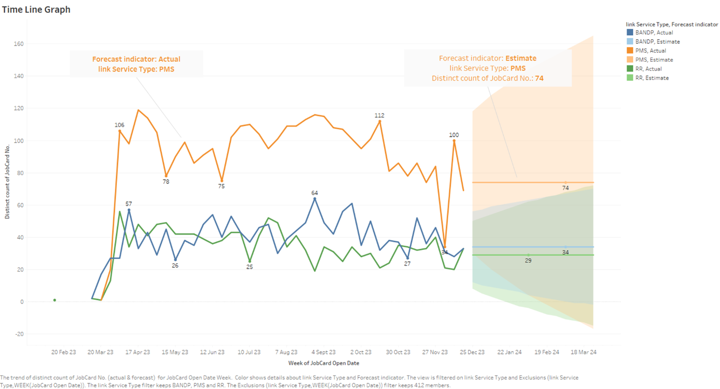
For the time series analyze we analyzed the most accessed such PMS , RR, BANDP .
With the help of forecasting method we forecasted some service and we found some information regard with the service

Slide 12

Generated OCR
https://forms.gle/PPRZza9Fjb3wmePW9

